Slide 1
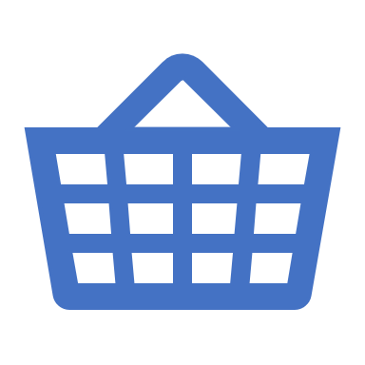
Basket Analysis by Using R
By Chen Wei

Slide 2
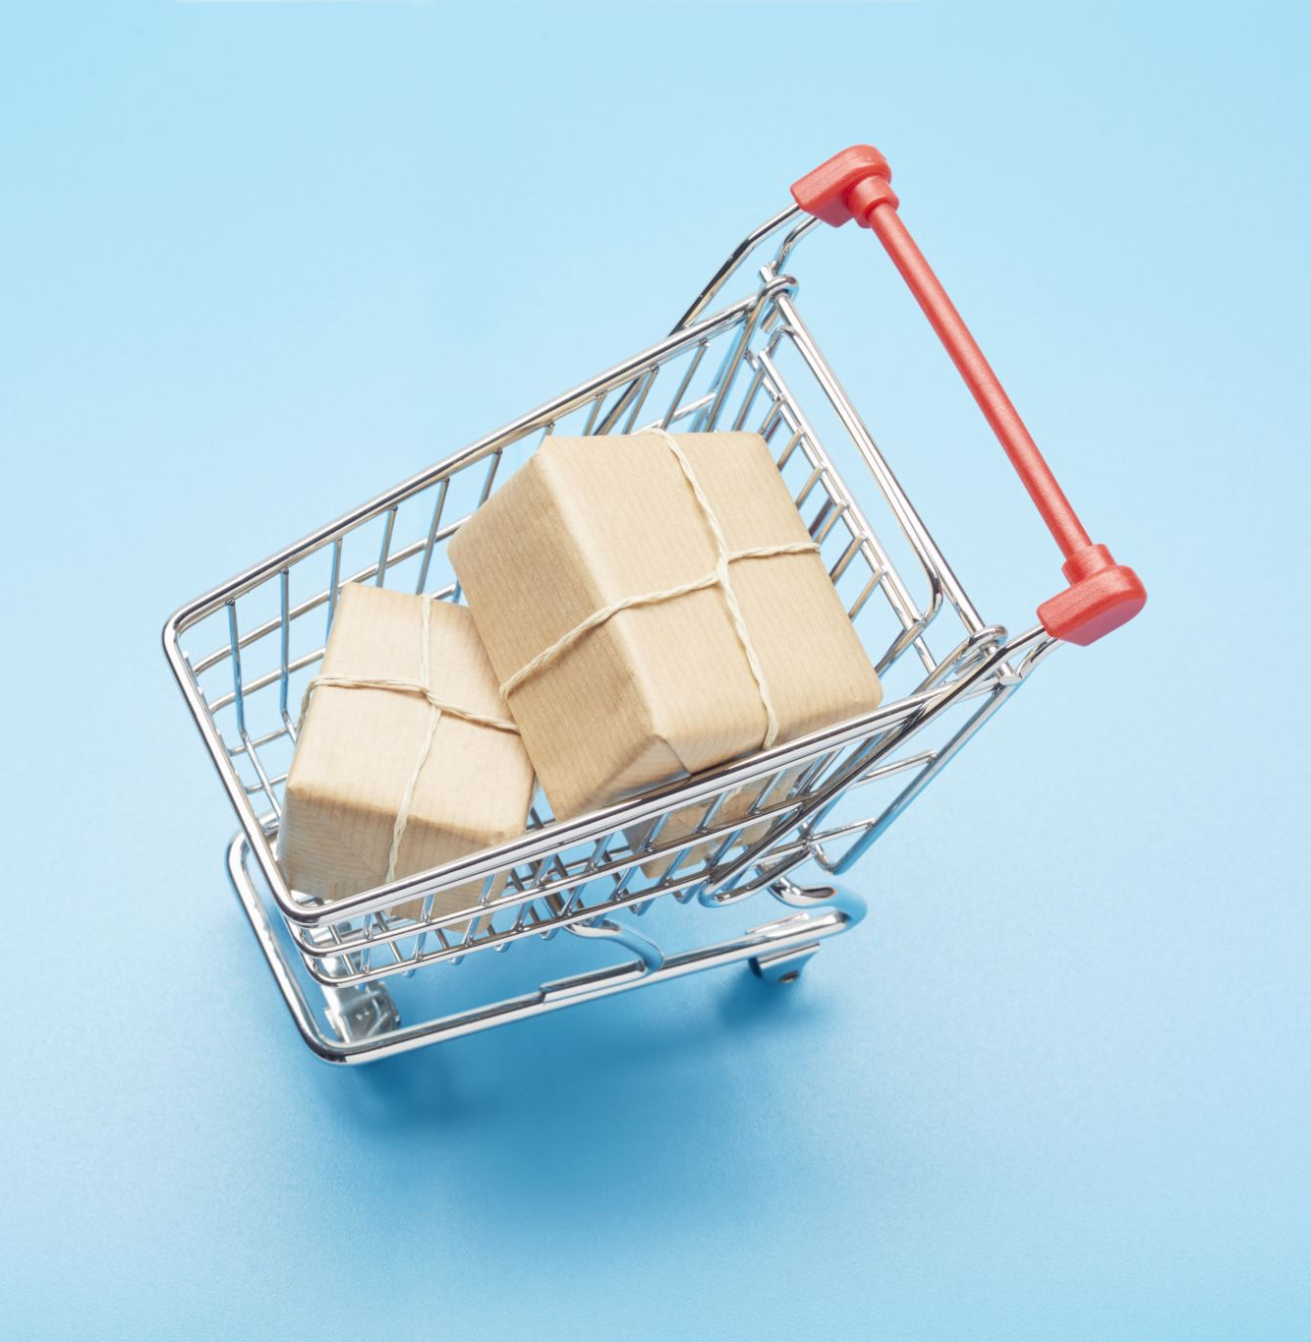
Outline
What is basket analysis
Import retail transaction data in R
Top 10 items
“ If this then that” -Association Analysis
Visualization
An example of sausage
What influenced sausage?
What did sausage influence?
Conclusion

Slide 3
What is basket analysis -identifies customers purchasing habits
lt provides insight into the combination of products within a customer's basket
The term 'basket' normally applies to a single order.
We often compare all orders associated with a single customer.
Ultimately, the purchasing insights provide the potential to create cross sell propositions:
Which product combinations are bought
When they are purchased
What sequence

Slide 4
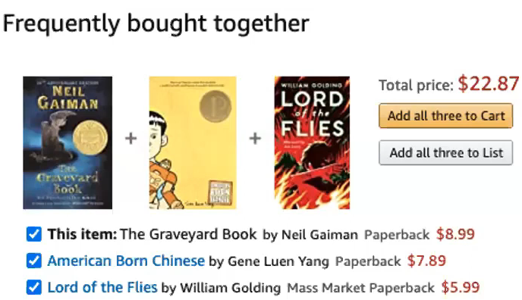
How basket analysis help the business
Promote the most profitable products
Encourage customers to buy items that they might overlook or missed
Changed the store layout
Customer behavior analysis
Cross marketing at online store
Customized emails with add-on sales

Slide 5
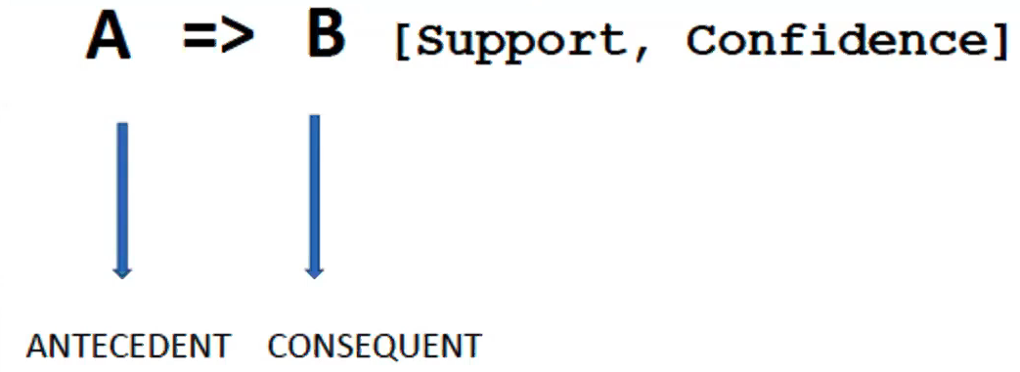
The association rule
{DIAPER} ->{BEER} [Support = 60%,Confidence = 75 %]
In 60 % of cases Diaper and Beer are sold together. ln 75 % of cases when someone purchases a Diaper, a Beer is also purchased

Slide 6


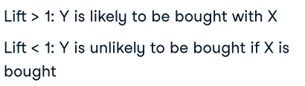
Measure of the rules
Support - Given an itemset X and Y, the support of X and Y, is the percentage of transactions that contain X and Y
Confidence of a rule, {X} -> {Y}
Lift of a rule, {X} -> {Y}

Slide 7
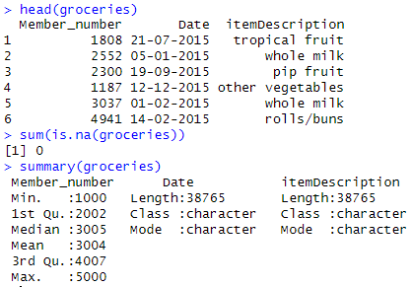
Import Groceries Transaction Data
groceries<- read.csv("Groceries_dataset.csv",strip.white =TRUE, na.strings ="" )
Groceries Transaction Data
2014 -2015
3 variables :
Member_number , Date,
ItemDescription
38765 records in total
No missing value
source data : https://www.kaggle.com/datasets/heeraldedhia/groceries-dataset/data

Slide 8
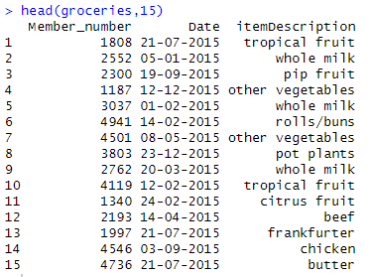
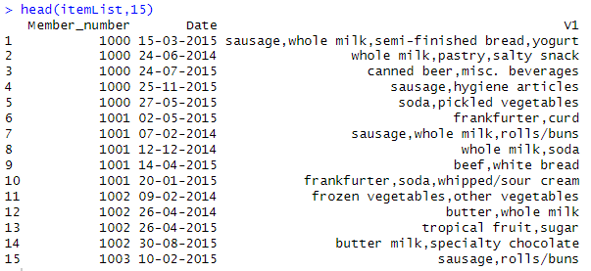
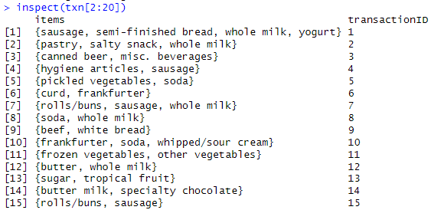
Transform to transactional dataset(Basket Format)
38765 records 14964 transactions (rows)

Slide 9
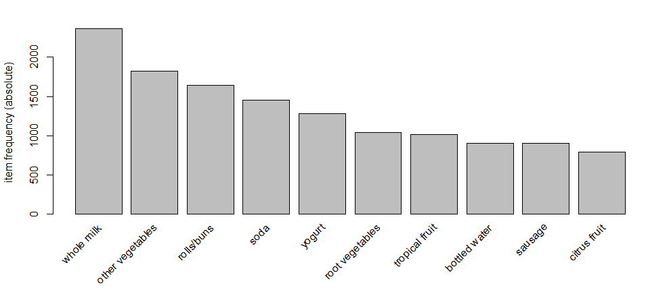
Frequency plot for the top 10 items
library(arulesViz)
itemsitemFrequencyPlot(txn,topN=10,type="absolute")

Slide 10
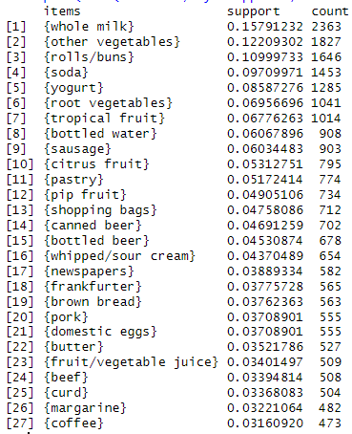
Top items by support /count
library(arules)
itemsets = apriori(txn, parameter = list(support = 0.03, target = 'frequent’))
itemsinspect(sort(itemsets, by='support', decreasing = T))
Support : popularity of an itemset"
Fraction of transactions that contain item
Support = count / number of total transactions

Slide 11
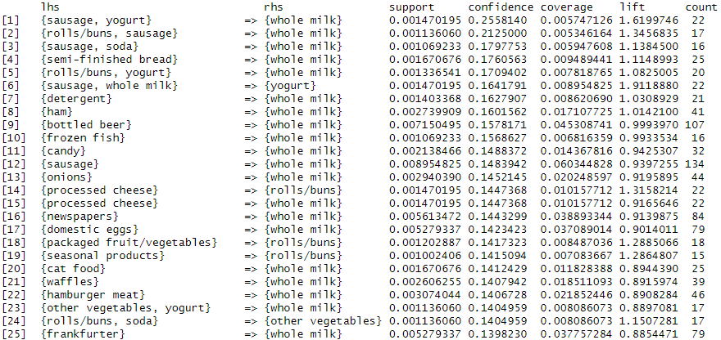
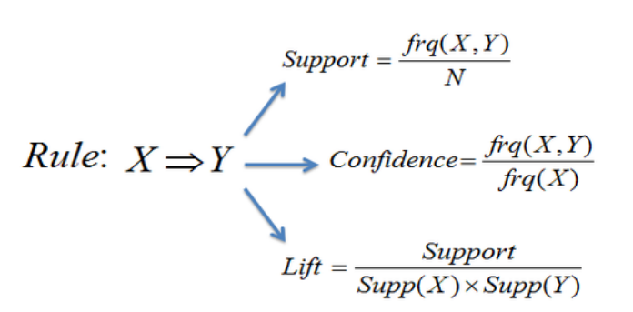



“ If this then that” with the apriori -Association Analysis
library(arules)
rules = apriori(txn, parameter = list(supp=0.001, conf=0.1, minlen=2), control = list(verbose=F))
rules<- sort(rules,by="confidence",
descreasing = TRUE)
inspect(rules)
Coverage = supp(X)
Probability for the antecedent alone in the entire dataset:
Detail report

Slide 12
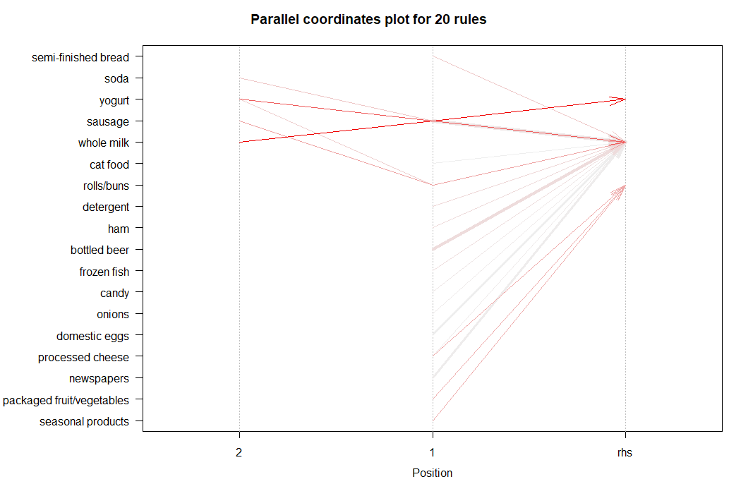
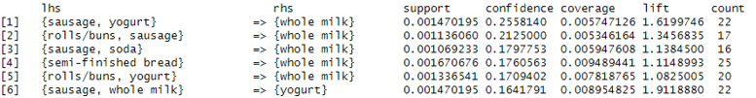

Parallel coordinates plot
library(arulesViz)
plot(rules[1:20], method="paracoord")
RHS is the Consequent we propose the customer will buy
The width of the arrows represents "support"
the intensity of the color represent "confidence".
Many rules have as consequent “milk" and “buns" - and that these rules have a large confidence.
eg. It shows us that when having whole milk and sausage in shopping cart, yogurt is likely to be brought together.

Slide 13
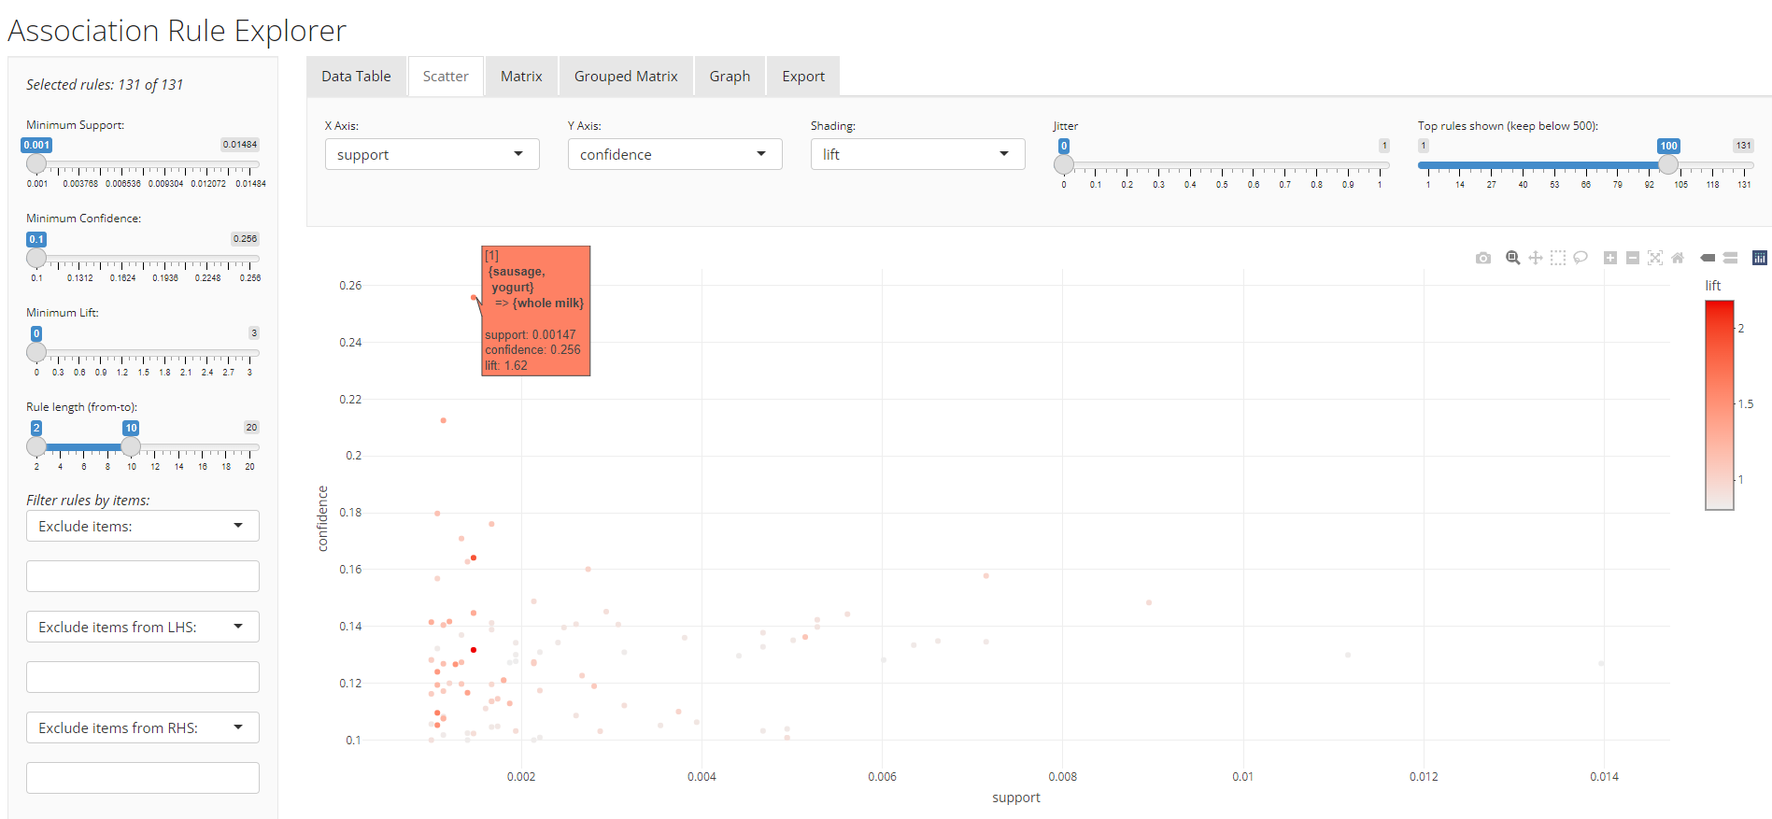
Scatter plots
The plot shows "Support" and "Confidence" on the x and y axis respectively.
One point on the plot represents exactly one rule.
The lift associated to the rule is used by color coding

Slide 14
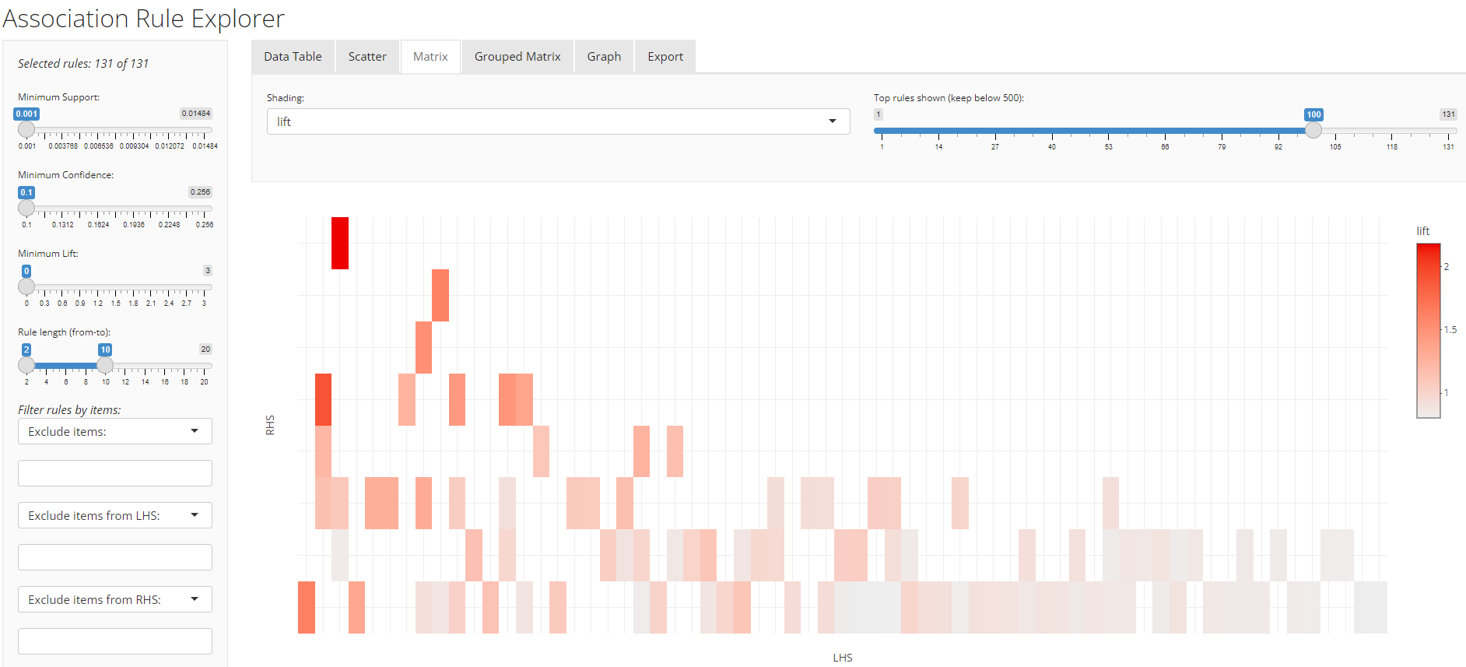
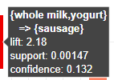
Matrix
The lift associated to the rule is used by color coding
Can easily see which rule has the highest lift
Sausage is likely to be brought with yogurt and whole milk

Slide 15
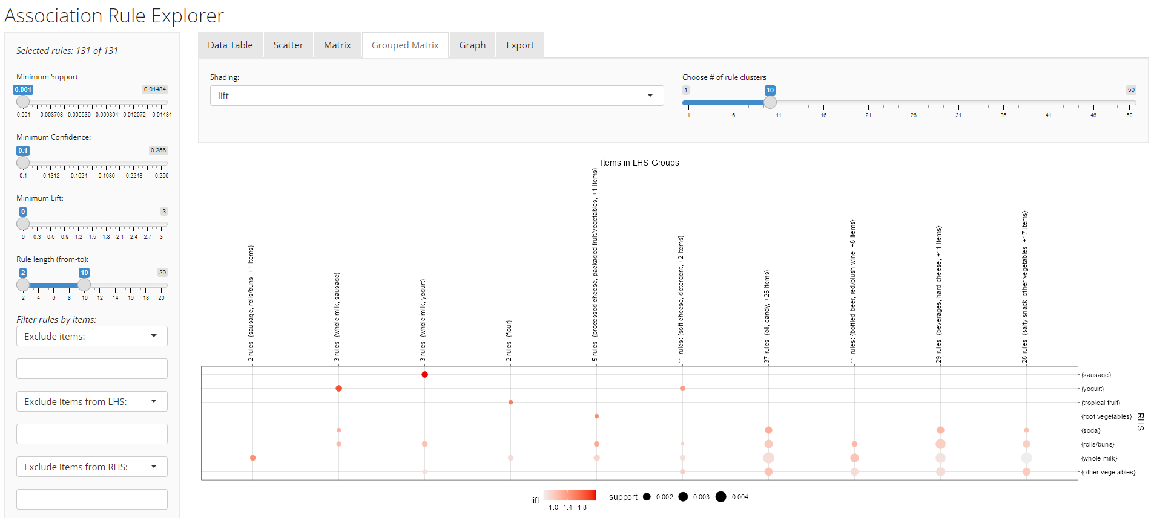
Grouped Matrix
Size represents support; Color represents and lift
Sausage is likely to be brought with yogurt and whole milk
Whole milk has higher frequency in certain transaction

Slide 16
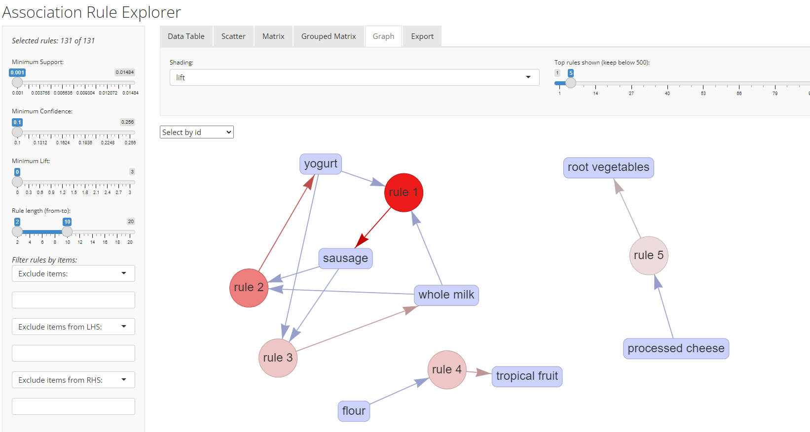
Interactive rules
Size of vertices represent support
Color of vertices represent and lift
Rule 1 has a highest lift – sausage is likely to be brought with yogurt and whole milk

Slide 17
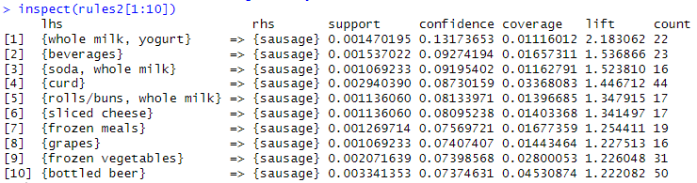



What influenced sausage?
rules2<-apriori(data=txn, parameter=list(supp=0.001,conf = 0.05, minlen=2), appearance = list(default="lhs",rhs="sausage"), control = list(verbose=F))
rules<-sort(rules2, decreasing=TRUE,by="confidence")
inspect(rules2[1:10])

Slide 18
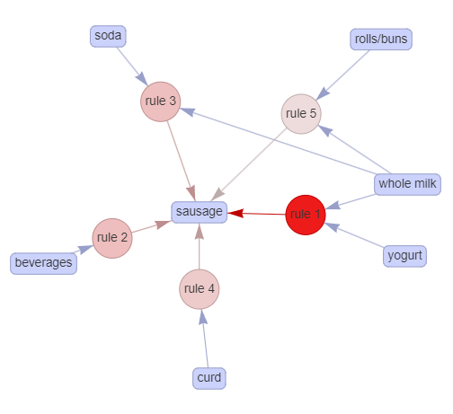
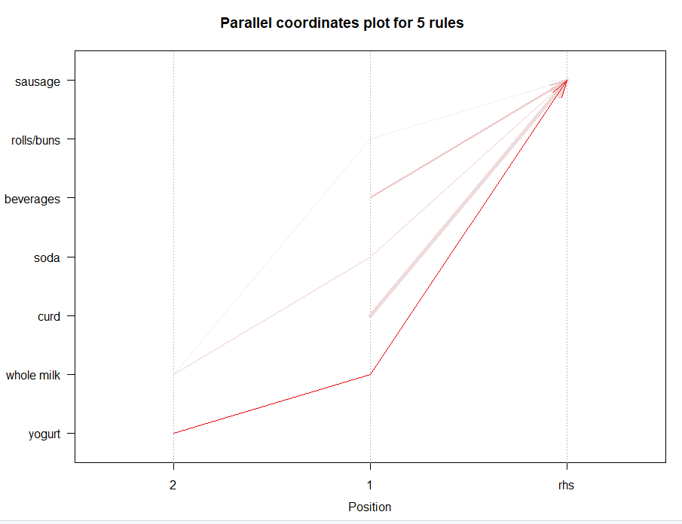
What influenced sausage?
Purchasing whole milk and yogurt triggers the purchase of sausage
A retailer could think of placing these items close to each other in the store such that it makes the shopping experience of the customer more convenient.

Slide 19
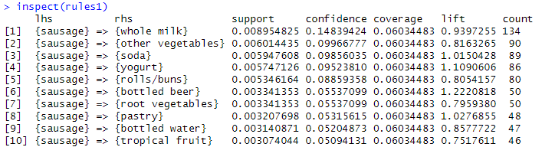




What did sausage influence?
rules1<-apriori(data=txn, parameter=list(supp=0.001,conf = 0.05,minlen=2), appearance = list(default="rhs",lhs="sausage"), control = list(verbose=F))
rules1<-sort(rules1, decreasing=TRUE,by="confidence")
inspect(rules1)

Slide 20
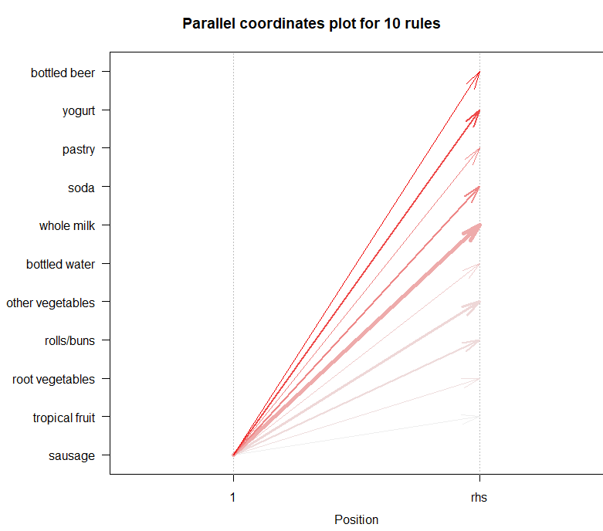
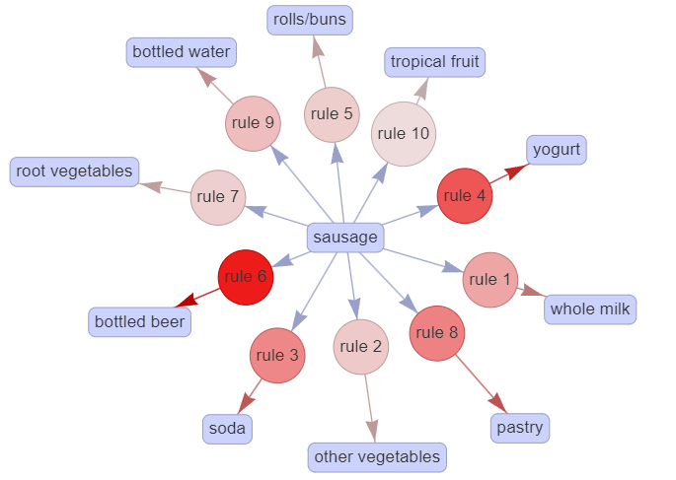
What did sausage influence?
Bottled beer is more likely to be brought with sausage

Slide 21
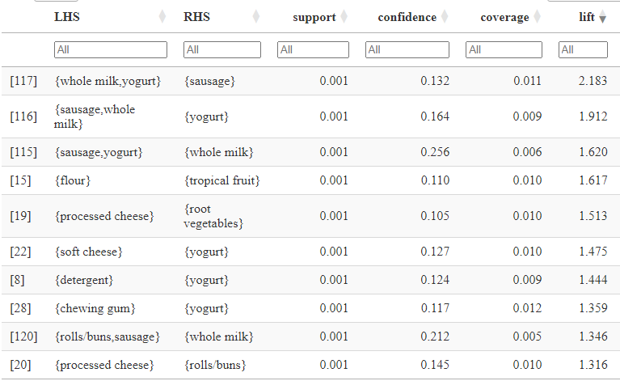
Conclusion
Order by lift
Promotion Strategies: Bundle Yogurt , whole milk and sausage for promotions to increase sales.
Cross-Selling： Association rules can be used for recommending related products.
Store Layout: place flour and tropical fruit closer to each other
Pricing Strategies: offering discounts to customers purchasing related items could be considered.
New Product Promotion： If certain item combinations are popular, they can consider introducing new products or packages related to those combinations

